Slide 1

NJ Dog Adoption
By:Mathieu Cadotte, Jessica Trusler, Robert Bernstein

Slide 2

Our Objective
Create an app that simplifies the process of finding and adopting a dog to match your lifestyle, preferences, and needs.
Use the “Adoptable Dogs” dataset to analyze what factors lead to adoption
Notes:
Despite the amount of dogs who need a home, people who want to adopt a pet face various challenges in finding the right pet for them
Existing methods of pet adoption can be time-consuming and confusing, causing frustration for potential adopters and reducing the chances of successful adoption
There is a need for a pet adopting app that can simplify the process of finding and adopting a pet, matching potential adopters with pets that suit their lifestyle, preferences, and needs.

Slide 3
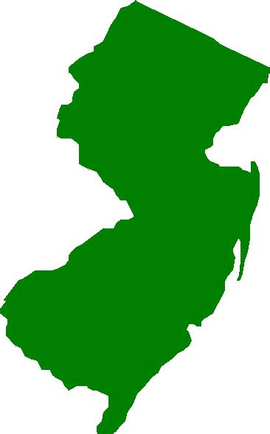
The Dataset
Dataset from Kaggle: Dog Adoption - A Journey To Find Their Forever Homes
The Dataset contains the data for adoptable dogs throughout the US including:
Id
Url
Breed_Primary
Color_primary
Age
Sex
Size
Coat
House_trained
Name
Contact_city
contact_state
Notes:
Our Dataset originally contained information on over 30,000 adoptable dogs across the United States, however the dataset was too large for Github so we pivoted to only include the adoptable dogs from New Jersey
The cleaned Dataset still included over 1000 dogs across the state and each dog included
Id: The Id of each individual dog
Url: Leading to Petfinder and dog adoption page
Breed_Primary: Primary breed of each dog and if it was mixed breed
Color_primary: Primary color of each dog
Age: Split into baby, young, adult and senior
Sex
Size: Split into small, medium, and large
Coat: Split into short medium, and long
House_trained
Fixed
Shots_current
Name
Contact_city
Contact_state
Contact_zip

Slide 4
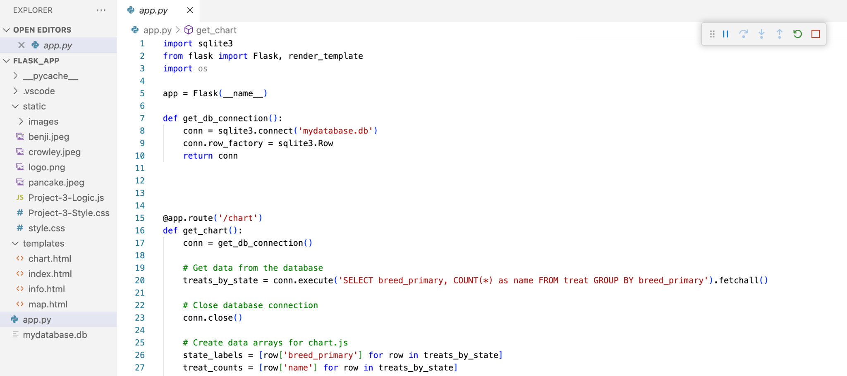
Python Flask API

Slide 5
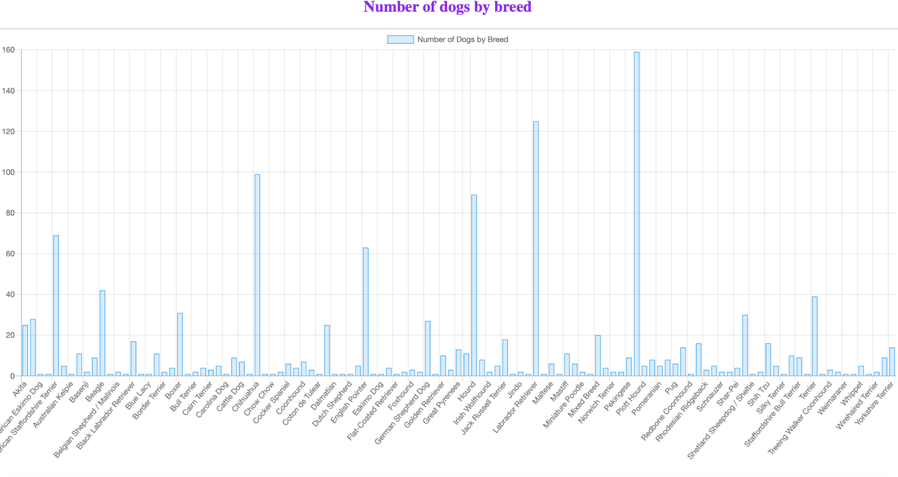
Chart.js

Slide 6
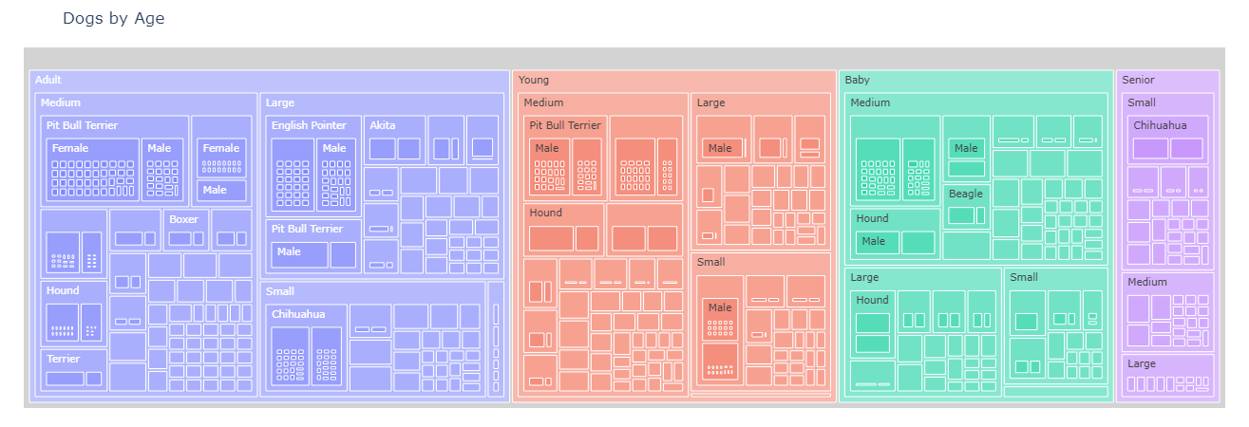
Nested Treemap
Notes:
Plotly treemap, built path ; age, size, breed, sex, name, url

Slide 7
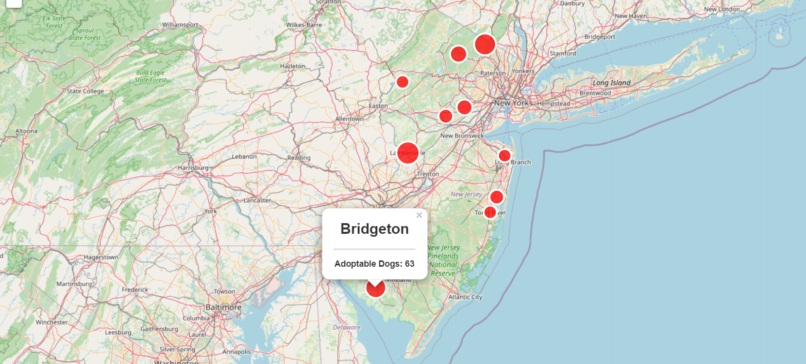
NJ Dog Adoption Map
Notes:
The Adoption Map was initially created by putting our NJ dog dataset csv into Python which allowed us to narrow down the data to the ten cities in New Jersey that contained the highest number of adoptable dogs
We then figured out the coordinates for each of the cities so we can use leaflet and OpenStreet Maps to manually create our map
The map itself has pop ups that tell you the city and how many adoptable dogs are located there
The maps markers are also proportionate to the amount of adoptable dogs located there

Slide 8
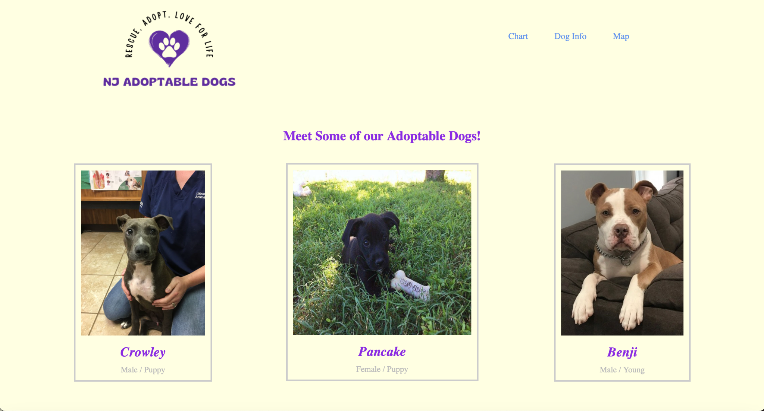
Live Demonstration

Slide 9

How does age affect dog adoption?
The age of dogs is a huge deciding factor in if they will be adopted, there we just over 300 puppies up for adoption compared to just over 1,000 for the rest of the dogs still waiting to be adopted.
With Senior dogs most are smaller breeds, which is a reversal from all other age groups.
Puppies account for the lowest population of adoptable dogs in the dataset.

Slide 10
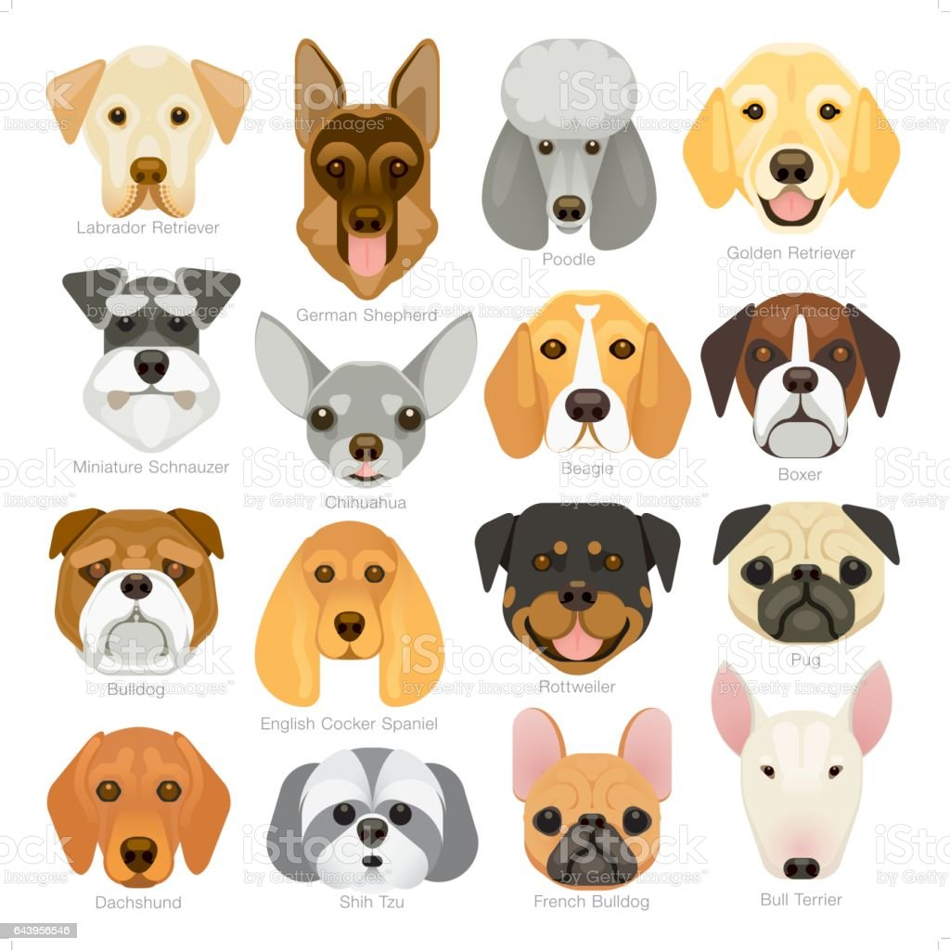
How does breed affect dog adoption?
Pitbulls accounted for 2 out of every 10 adoptable dogs in our dataset due to people believing they have behavioral issues
Labrador Retrievers account for 125 of the adoptable dogs in the dataset. As America’s “most loved dog” they are extremely overbred and often end up in shelters
Smaller dog breeds are less popular as they grow in age consisting of about 60% of the senior dogs in the dataset
Notes:
Pitbulls accounted for 2 out of every 10 adoptable dogs in our dataset due to people believing they have behavioral issues
Labrador Retrievers account for 125 of the adoptable dogs in the dataset. As America’s “most loved dog” they are extremely overbred and often end up in shelters
Smaller dog breeds are less popular as they grow in age consisting of about 60% of the senior dogs in the dataset

Slide 11
Limitations of the Dataset
Only a snapshot of one day’s data, so it is difficult to see how long certain dogs stay up for adoption, or how quickly other dogs are adopted.
The dataset also lacked longitude and latitude for each dog resulting in a lack of accuracy in their location.
The original dataset was over 30,000 dogs and due to limitations on GitHub we had to limit it to only New Jersey.

Slide 12
Key Takeaways
Age is a big factor in adoption leading the majority of people to adopt puppies which only make up about 20% of our dataset
Breed is also another important factor which is evidenced by Pitbulls accounting for 20% of all breeds up for adoption in the dataset
Location is a crucial factor in adoption with more than a third of all adoptable dogs in our dataset were from the ten cities included in the map
Notes:
Next Steps if we had more time:
Try to do a more in depth EDA on the dataset
Try to get an API or more coordinates to create a more complex map
Try to get data over time so we can understand how adoption changes over a certain period

Slide 13


